Slide 1
Automated Segmentation of 3-D Brain Imaging Data Using Convolutional Nets
Gerald Pho
December 20, 2018

Slide 2
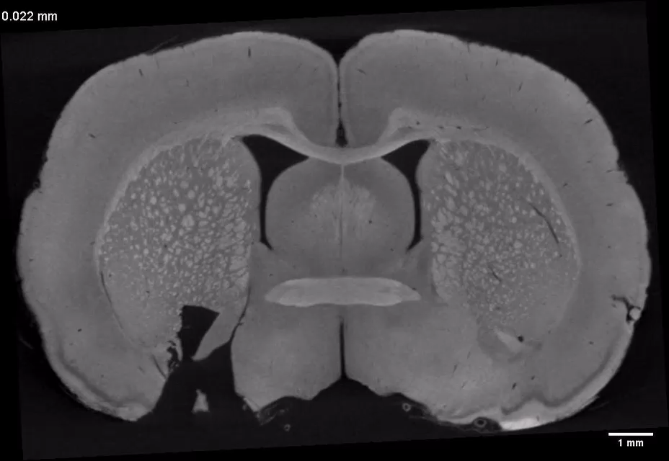
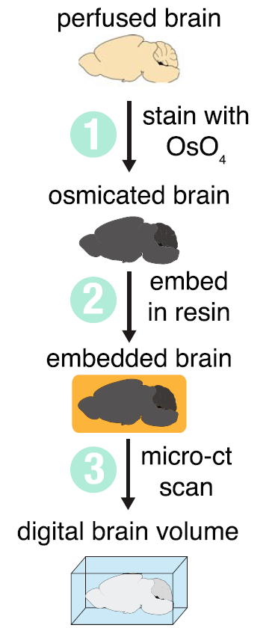
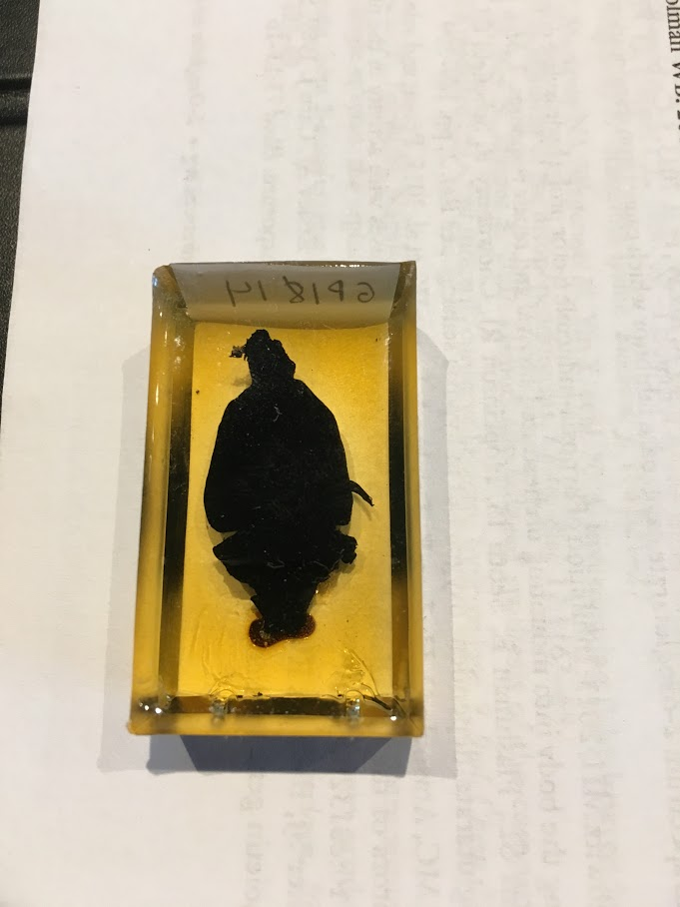
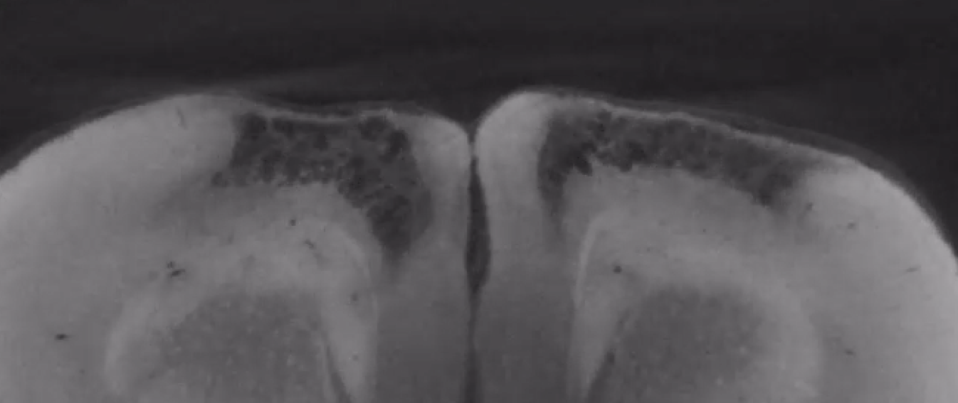
Goal: Quantify brain lesions with micro-CT volumetric imaging
Masis et al 2018
Can we use ML to automatically segment these volumes with sparse training data?
Manual annotation is laborious, especially in 3-D

Slide 3
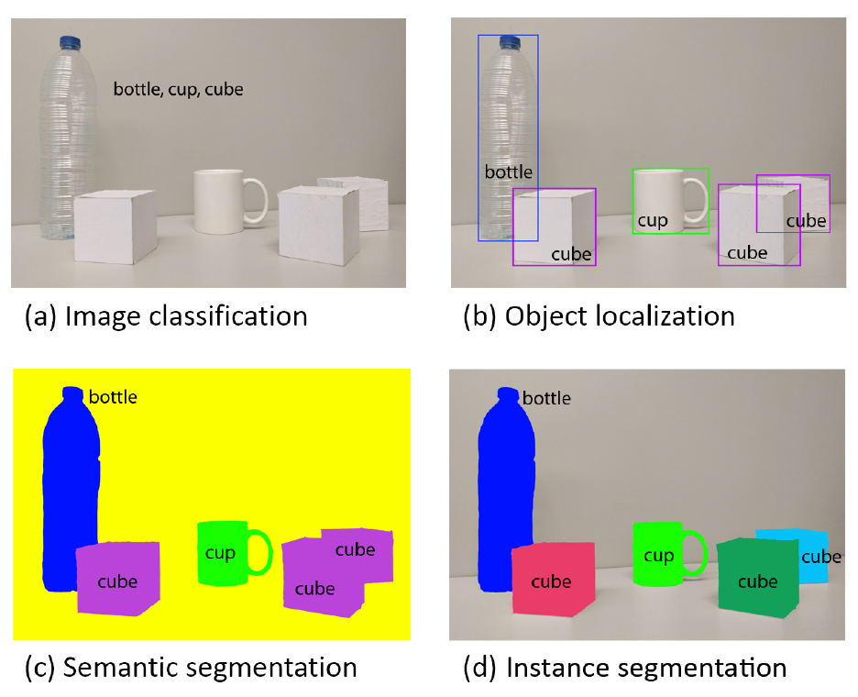
The general ML problem: semantic segmentation
Deep networks are widely successful for classification (predict label per image)
How can we use deep networks for segmentation (predict label per pixel) ?
Garcia-Garcia et al, 2017

Slide 4
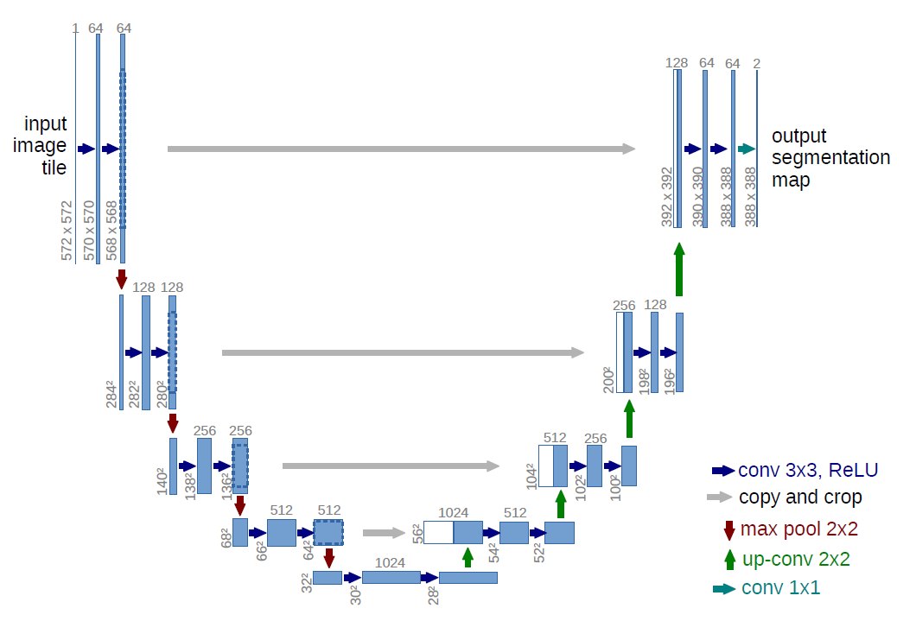
The approach: U-Net…
A type of Fully Convolutional Network (FCN) – pixels to pixels w/ no dense layers
Input: image
Output: another image with each pixel encoding the probability per class
Contracting path (left) = just a CNN!
Expanding path (right) = upsample
Skip connections = concatenate
right (deep features for generalization) w/ left (high-res features for localization)
FCN: Long et al 2015
U-Net: Ronneberger et al 2015

Slide 5
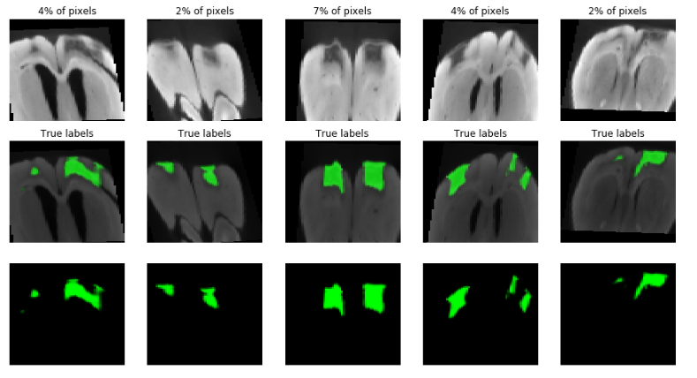
… plus heavy data augmentation
Sparse training data → need augmentation!
3 rat brain volumes, each about 1000 x 600 x 600 → downsample and crop to 128 x 64 x 64
Augmentations:
Rotation
Translation
Flip (horizontal)
Shear
Brightness
Future work: random elastic deformations

Slide 6
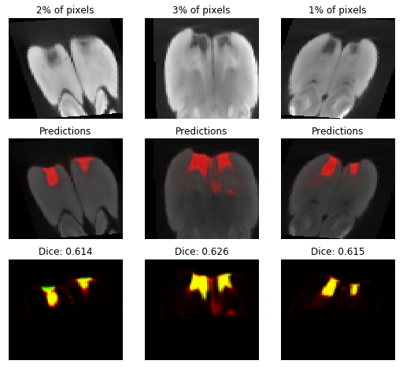
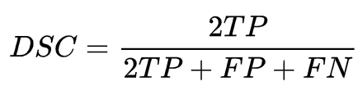
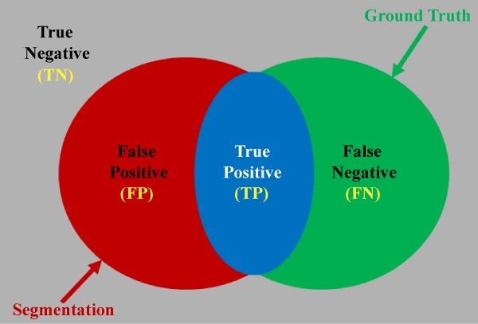
Evaluation metric and loss function
Performance on training data
Dice coefficient for evaluation
Weighted cross-entropy for loss function
Class imbalance: give high weight to lesion pixels

Slide 7
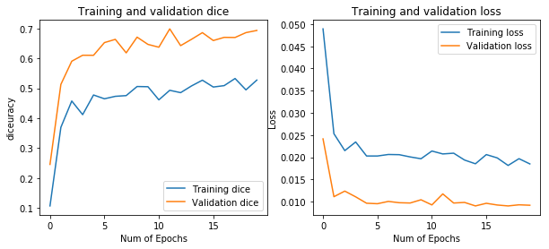
Training and validation loss
Trained for 20 epochs of 100 augmented images (~15 minutes)

Slide 8
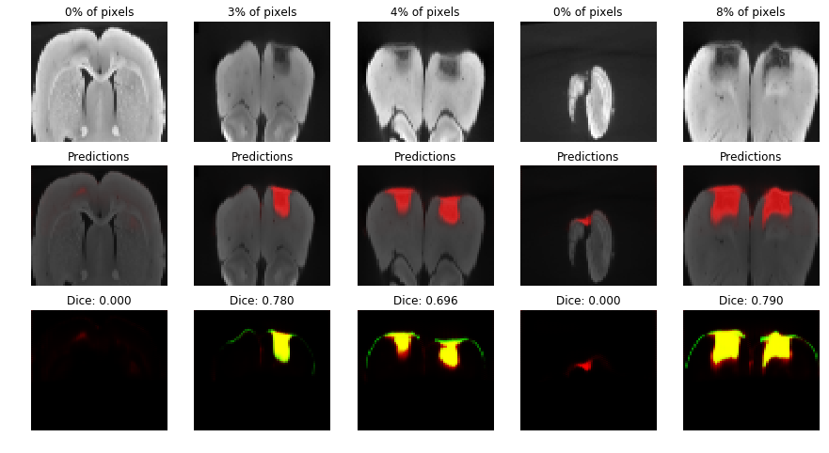
Performance on test data

Slide 9
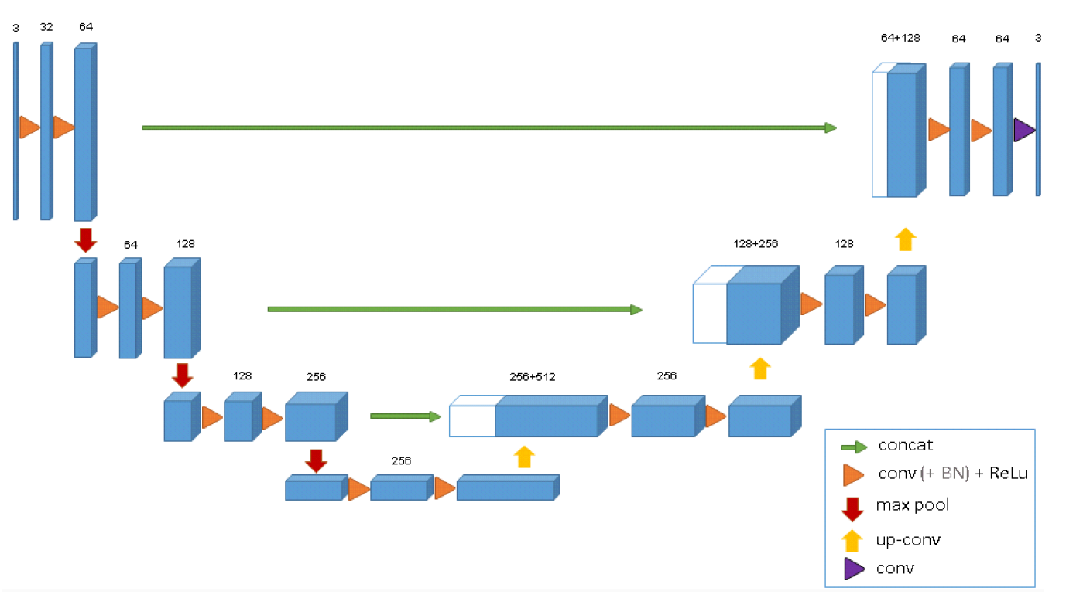
3D U-Net
Goal: Go from a sparsely labeled volume to a fully labeled volume
Labels have 3 classes: Lesion, Non-lesion, and Unlabeled
Output has 2 classes: Lesion, Non-lesion
→Force network to make predictions on unlabeled data
Set training weight of unlabeled class to zero → has no effect on training loss!
Cicek et al 2016

Slide 10
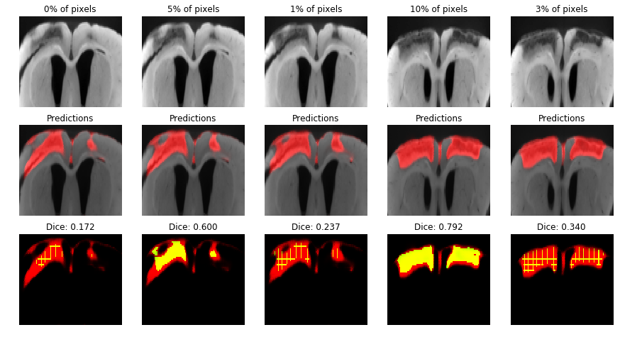
3D U-Net performance
Trained for 20 epochs of 30 augmented volumes (20 minutes)

Slide 11
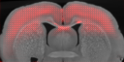
3D U-Net tends to over-estimate lesion size
Unclear whether it’s due to suboptimal choice of class weight or something else

Slide 12
Conclusion and references
U-Net is a powerful approach for semantic segmentation
Even just a 2D U-Net can work pretty well!
Data augmentation is very helpful in case of sparse data
U-Net paper = Ronneberger et al 2015
3D U-Net paper = Cicek et al 2016
Useful starting code for U-Net: https://www.kaggle.com/keegil/keras-u-net-starter-lb-0-277

